Slide 1
Team 5 Project 1 Presentation:
My Little Princess Dress Web Site
Georgia Tech Coding Bootcamp

Slide 2
Agenda

Slide 3
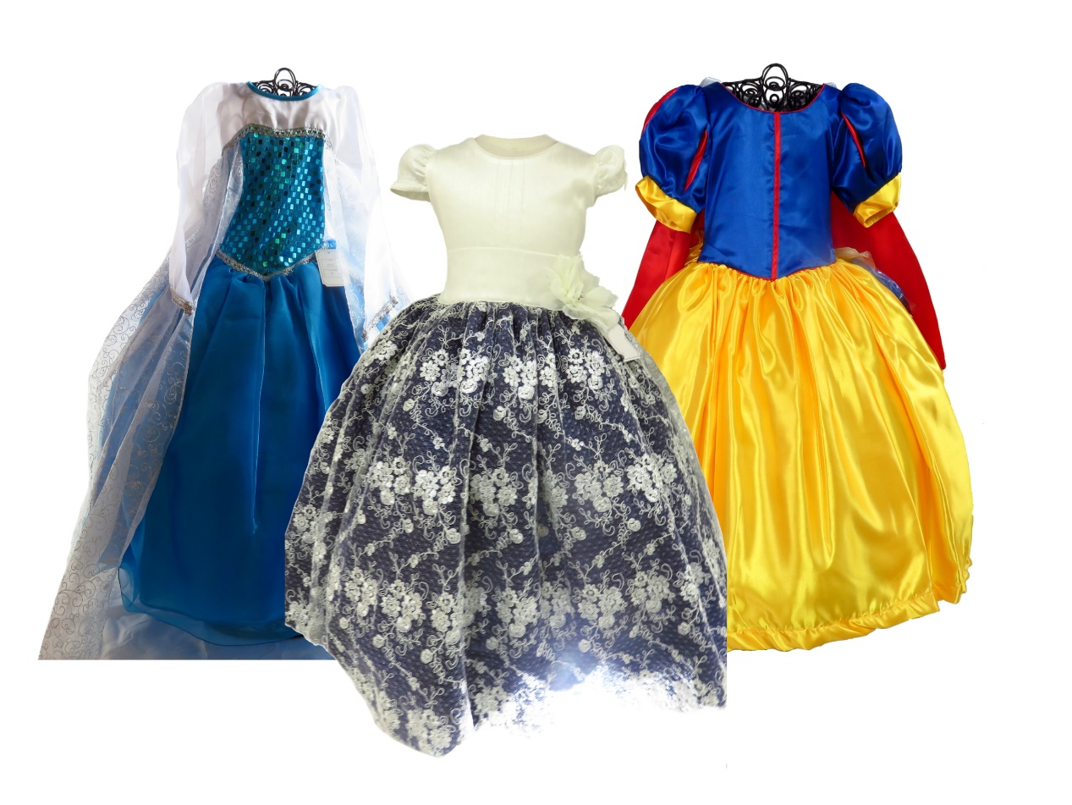
Agenda
Team Presentation
Overall Concept and Motivation
Design Process
Technologies used
Demonstration
Future Development

Slide 4
Overall Concept and Motivation
Concept
We have considered to present to you an E-commerce site for My Little Princess Dress.
This is a 5 year-old family-owned company sells dresses for costume parties, First Communion and Baptism to the local market.
Company does not have a web site to show its products
It creates the perfect opportunity to apply Web Design concepts learned at this point.

Slide 5
Overall Concept and Motivation
Motivation
We estimated that the chances of developing an E-commerce site are greater than creating an application
We considered that learning and in some cases mastering the technologies available in the market will help us to either implement or manage similar projects

Slide 6
Design Process
Business Requirements
&
Project Proposal
Functional Requirements
High Level Design
Research
Implementation
Focus on major functionality first
Documentation
Basic Research
Divide tasks and assign responsibilities
Diagrams
Map functional requirements into Web Components
Scope Review, Risk and Issue management

Slide 7
Technologies Used
Bootstrap
Firebase
Styles on all pages
Product Catalogue
Product Pictures
Load information to Product page
USPS API
PayPal API
Address validation
XML Response
Simulate transaction

Slide 8
Compliance – Partial list of compliance
1 | Must Use two APIs | Compliant | We will use 2 APIs: USPS API to verify customers address PayPal with sand box account to perform transaction
2 | Must Use Ajax to pull data | Compliant | We will use AJAX to get the data from the APIs
3 | Must utilize at least one new library or technology that we haven’t discussed | Compliant | The Photo presentation will use a new library to create the slide shows and the photo presentation
4 | Musts have a polished front end | Compliant | We will use bootstrap to create friendly elements (colors, paragraphs, fonts) We are considering the target audience for the design (Mom’s and girls) t
5 | Must meet good quality coding standards | Compliant | We have set the following standards: Indentation with tab character Variable naming convention: Function naming convention File naming convention
6 | Must not use alerts, confirms, or prompts | Compliant | We are not using any of the mentioned elements
7 | Must have some sort of repeating element (table, columns, etc.) | Compliant | We are repeating the navigation bar, the footer, and the header.
8 | Must use Bootstrap or Alternative CSS Framework | Compliant | We will use Bootstrap
9 | Must be Deployed | Compliant | We will deploy at Github page
10 | Must have User Input Validation | Compliant | We will validate characters in the forms we will use (alphanumeric, special characters, numeric – prices)
** See Team5 - Project1 Proposal and HLD - v1.2 for additional details

Slide 9
Demonstration

Slide 10
Future Development

Slide 11
List of improvements
Layout and overall presentation improvements
Validations on all the pages
Improve media files
Transfer information from Product Page to Paypal
Transfer information from Firebase to Purchase Form
Add more fields to product catalogue
Update product catalogue with purchase information.

Slide 12
THANKS
Team 5: David, Antonio, Victor, German

